Slide 1

The Devil’s in the Details!
Do’s and Don’ts for Making a Successful Editor Transition: Lessons Learned in Passing the Baton
Tina Marrelli, MSN, MA, RN, FAAN
Maureen Anthony, PhD, RN

Slide 2
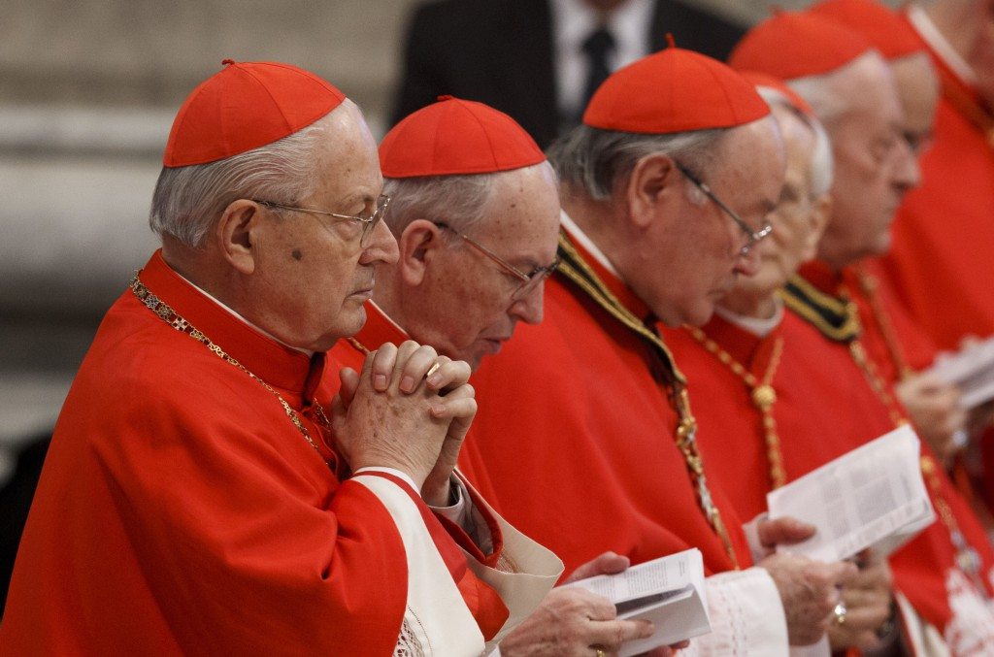
Transitions

Slide 3
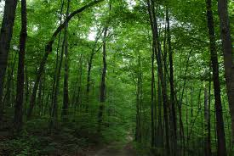
The Forest

Slide 4
The Forest
Home Healthcare Nurse published by Lippincott – in its 32nd year
Inter-professional and specialty Journal
10 issues/year
Additional digital content
Webpage: http://journals.lww.com/homehealthcarenurseonline/pages/default.aspx

Slide 5
Immediate Need-to-Know
What’s in the pipeline? (Do not assume!)
  In review
  Accepted
  Back log
Transferring/responsibility for works-in-progress
Rejected or recently rejected manuscripts (Good to know which authors have submitted before with problem papers)
Need to have reviewers and authors lined up

Slide 6
The Forest cont’d
Editorial board/Reviewers
  Change or keep? Pros and cons
Work flow processes
Pages per issue
Quantifiable stats
  Submissions, rejections, accepts per month

Slide 7
The Forest cont’d
Author guidelines/word limits/journal style
Terminology – A new glossary!
  Stubs
  Wells
  Call-outs
  Figures
  Sidebars
  Manuscript/submission versus an article
  And more….

Slide 8
The Forest cont’d
Planning issue content
Substantive versus copy editing
Identifying and developing authors
  Conferences
  Past authors
  Board members/Peer reviewers
  Send thank you notes and invite to write again!
Proofing processes

Slide 9
Overview of Ethical Considerations
Plagiarism
Self-plagiarism
Authorship
Three tenets of authorship
Honoring accepted manuscripts of former editor

Slide 10
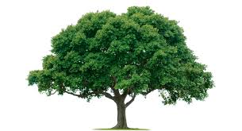
The Trees

Slide 11
The Trees
Reviews – It’s all about communication
  “Word-smithing” and APA checking versus quality of content and interest to readers
  Handling divergent, non-congruent reviews
  Revisiting the goal of peer review
  Rewarding reviewers (CE’s, small gifts)
  Accept/Revise/Reject
  Second reviews of revisions
  Reject without review

Slide 12
Trees cont’d
Sample letters
ESL/International manuscripts/references
Author forms
  CTA
  CE Disclosure
  Reprints
  Patient consents
  Permission for images

Slide 13
Trees cont’d
Requirements for images
Handling email queries
Know/learn editorial style (APA, AMA, Chicago)
At what point to stop editing? – revise/reject
Writing kind rejection letters
Editorial calendar/themes

Slide 14
Trees cont’d
Managing work flow
  Organizing documents
  Organizing manuscripts
  Authors’ contact information
  Reviewers and specialties
  What happens if e-system crashes?

Slide 15
Trees cont’d
Deadlines
  When issue is due
  When proofs are expected
Delegation
  Guest editorials
  Editorial board
  Other

Slide 16
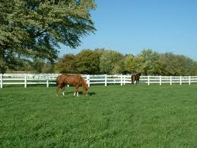
The Pasture

Slide 17
The Pasture
Helpful conferences for soliciting authors
Developing authors as peer reviewers
Negotiating travel funds (media, digital podcasts)
Advertising
Possible topics and rotation of topics
Query letters

Slide 18
Pasture cont’d
Know your resources
  Previous editors
  Production office
  Editorial manager system
  INANE
  COPE
  www.icmje
  Editors Handbook (Lippincott)
  Anatomy of writing for publication for nurses (STT)
  Writing for Publication for Nurses (Oermann)
  Peer editors

