Slide 1

Mapping the Terrain of Publication Ethics: 16 years of COPE Cases
Geraldine Pearson, PhD, APRN, FAAN
Charon A Pierson, PhD, GNP, FAAN, FAANP
Elected members COPE Council
Notes:
1

Slide 2

Competing Interests
We have none to declare

Slide 3
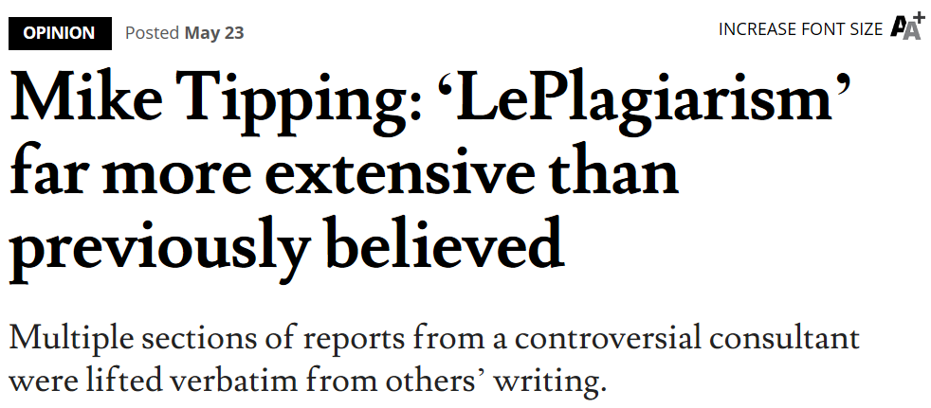

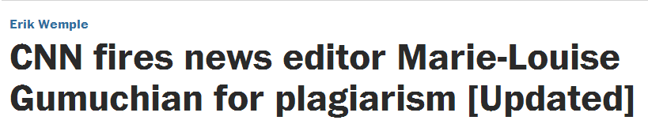
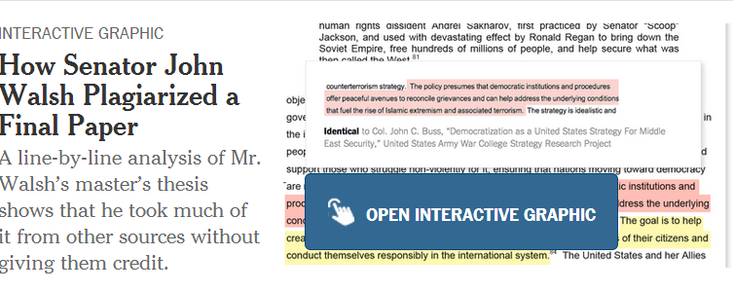

Plagiarism in
the News

Slide 4

.
http://publicationethics.org

Slide 5
COPE history
Began in 1997 as an informal forum for editors in the UK to discuss ethical issues related to research and publication in biomedical journal publishing
In 2007-08 established as a limited company and a UK-registered charity
Currently >9000 members, from >75 countries
All academic disciplines are covered
20 Council members from 11 countries and a range of disciplines
Notes:
5

Slide 6
COPE structure
Work guided by an elected Council and elected Officers, who work voluntarily
Day-to-day management of business affairs handled by three permanent staff (paid): Operations Manager, Natalie Ridgeway; Administrator, Linda Gough;
Web Manager, Cynthia Clerk
Specific projects managed by various sub-committees of Council members
Notes:
6

Slide 7
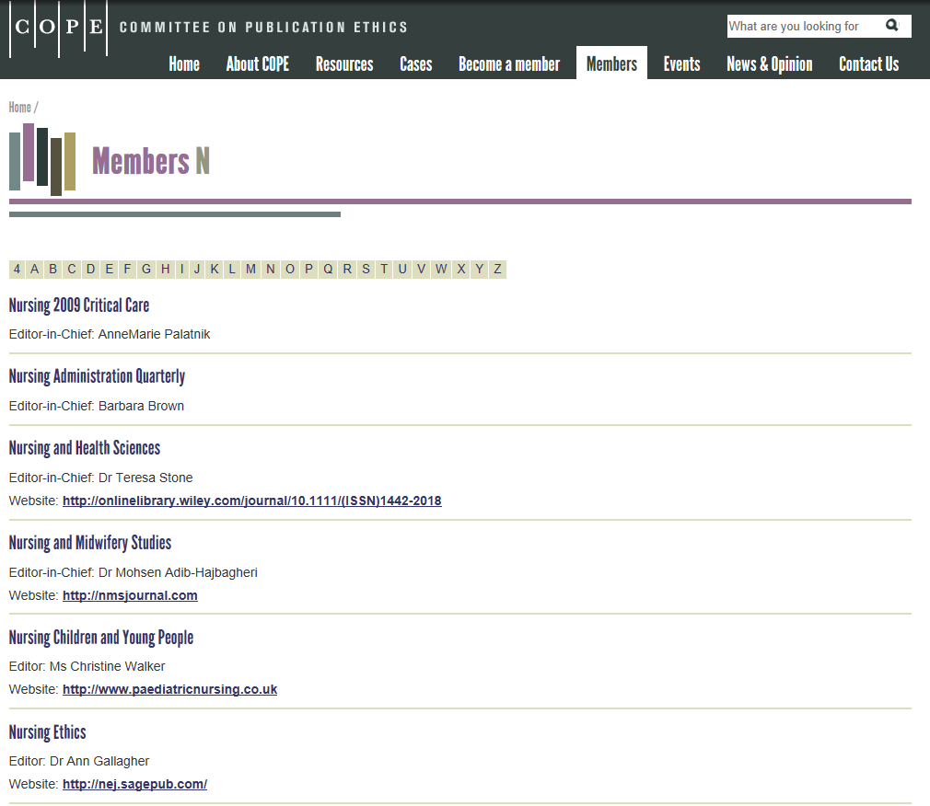

Slide 8
Forums
COPE offers advice and guidance to its members, primarily through its scheduled forum meetings:
Held in person or via webinar
Allow members to benefit from views and experiences of other members
Cases presented anonymously
Text summaries and audio recordings published on the website (database of >500 cases, searchable by year and keywords)
Members can contact COPE between forums for advice on urgent cases
Notes:
8

Slide 9
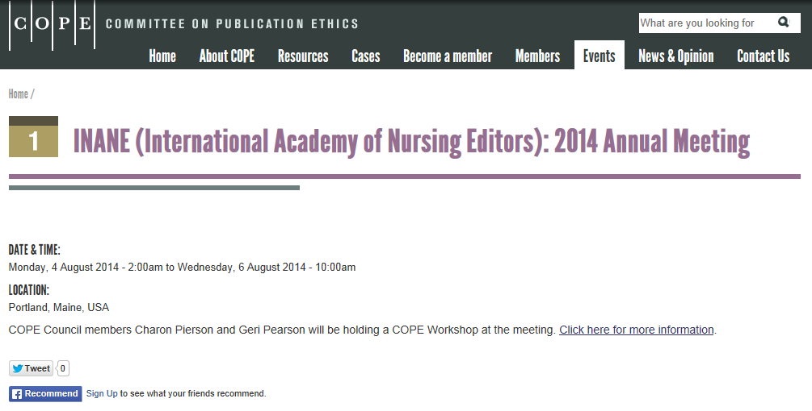
First COPE Forum for INANE – Portland, ME

Slide 10
COPE - Case Analysis Project
Analysis of 16 years of COPE Cases (1997- 2012)
Team: Irene Hames (COPE Council), Charon Pierson (COPE Council), Natalie Ridgeway (COPE Operations Manager) Virginia Barbour (COPE Chair)
Presented at 7th International Congress on Peer Review and Biomedical Publication 8 September 2013, Chicago

Slide 11
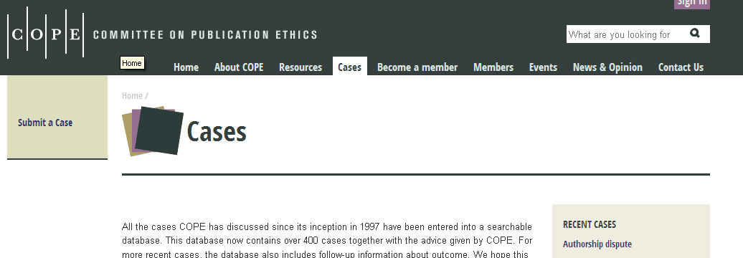
.
Cases database – approximately 500 cases
Updated classification scheme needed
New scheme - 18 main Classifications, up to 2 per case
- 100 Keywords, up to 10 per case
- descriptive, not judgemental
The coding exercise
Classifications and Keywords indicate the topics discussed, not that a particular form of misconduct had occurred

Slide 12
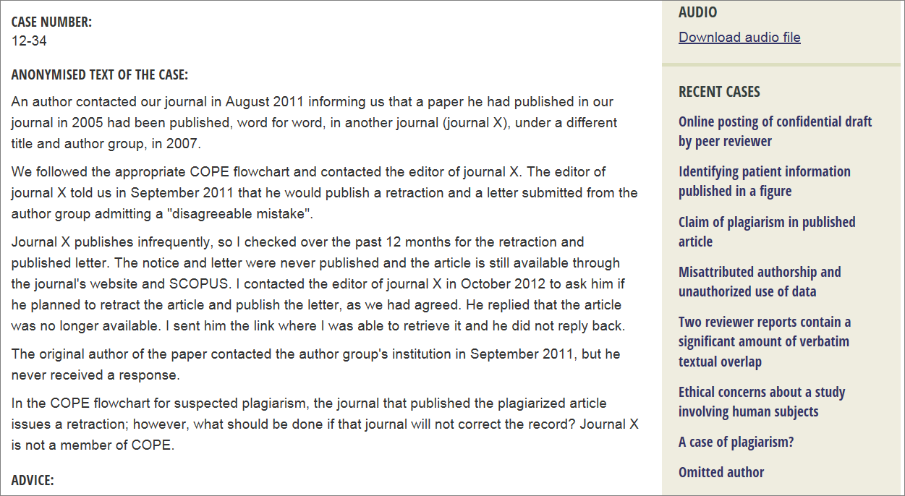
Journal refuses to correct the record
Notes:
Classifications: Plagiarism, Correction of the Literature
Keywords: plagiarism, plagiarism in a published article, correction of the literature, correction of the literature-retraction

Slide 13
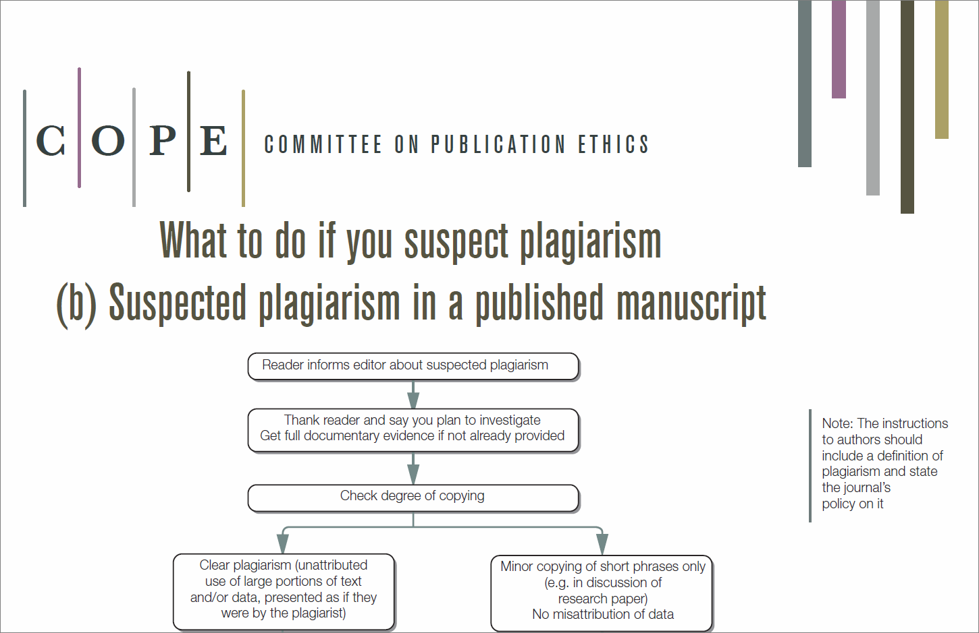

Slide 14
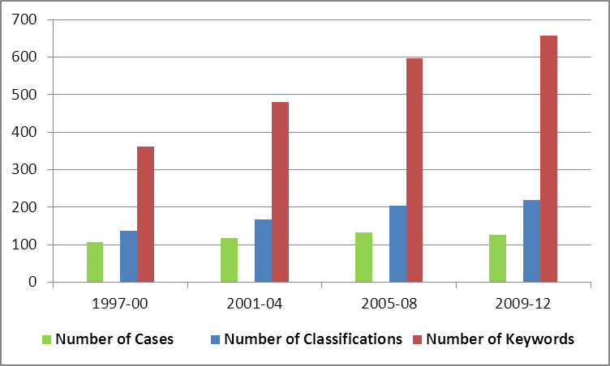
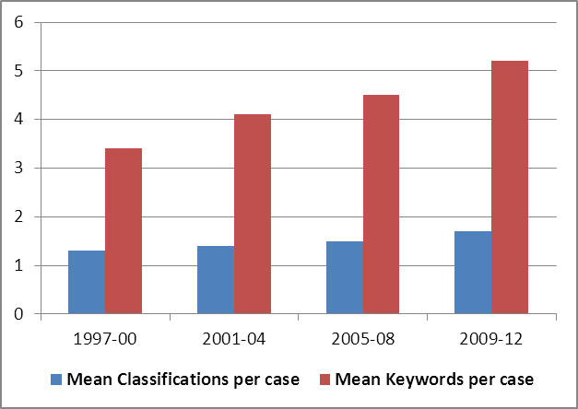
Cases, Classifications & Keywords
1997-2012 by 4-year intervals
Number
Mean

Slide 15
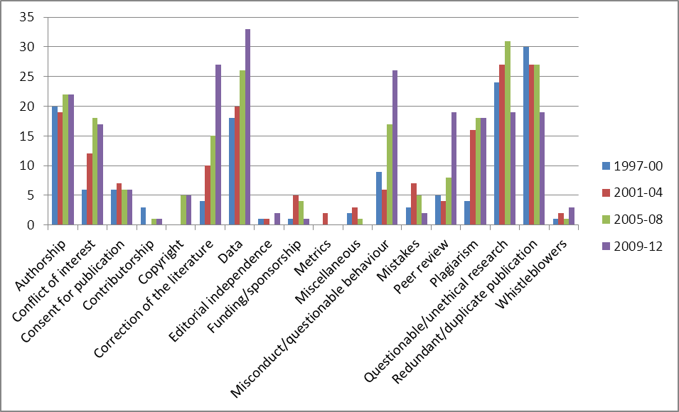
Classification of COPE cases, 1997-2012

Slide 16
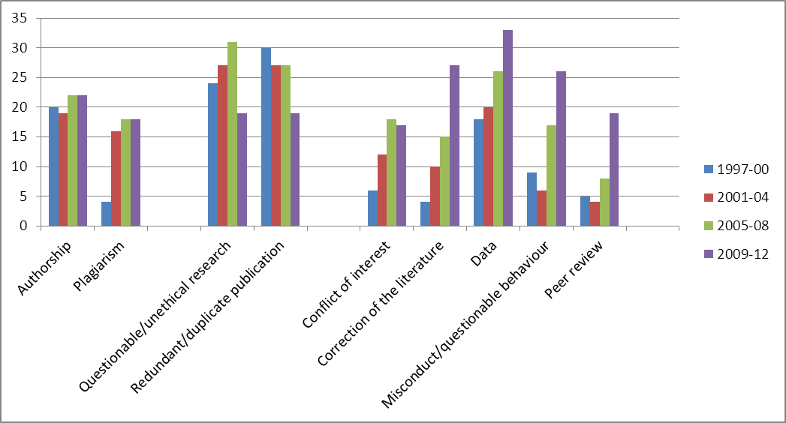
Classification of COPE cases, 1997-2012, categories with >7 instances in a 4-year period

Slide 17
COPE resource development
eLearning modules re-launched 2013: Introduction to publication ethics, Plagiarism, Data falsification, Data fabrication, Conflict of interest, Authorship, Reviewer misconduct
eLearning modules in development: Editor misconduct, Redundant publication, Selective reporting, Unethical research
Discussion documents: How should editors respond to plagiarism, Responding to anonymous whistle blowers, electronic responses to blogs and journal articles
New and enhanced Flowcharts in progress
New Guidelines … on peer review …

Slide 18
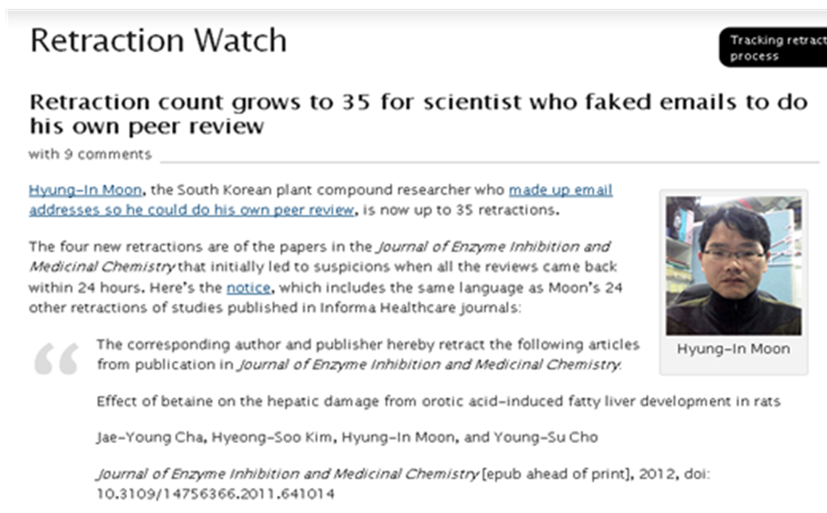
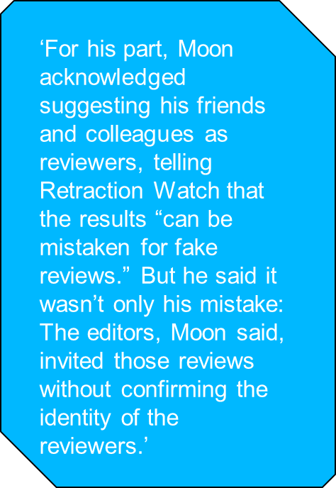
‘Fake reviewer’ cases
Notes:
The journal is a member of COPE (Informa Healthcare)

Slide 19
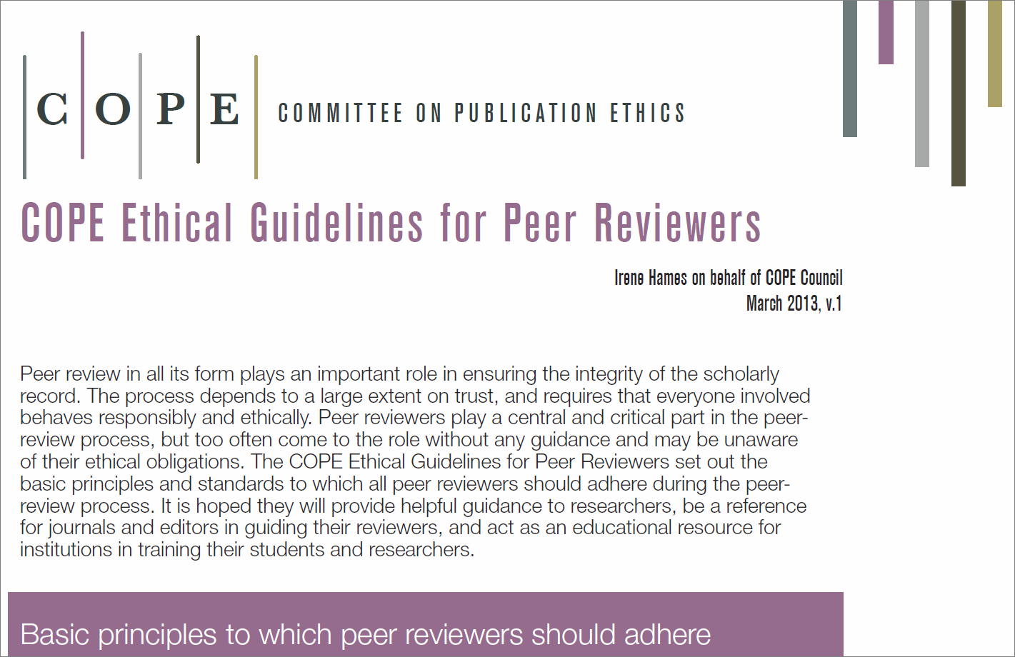
.
http://publicationethics.org/resources/guidelines
http://publicationethics.org/files/u7140/Peer%20review%20guidelines.pdf

Slide 20

  ‘Promoting integrity in research publication’
  Education as well as guidance and advice
  Making the Forum accessible to more members, more often, in more ways
  Resources you can use freely in your editorial work
  ~~~~~~~~~~~~~
Comments/queries for COPE: Natalie Ridgeway Operations Manager
cope_opsmanager@publicationethics.org @C0PE
Website: http://www.publicationethics.org/
Notes:
20

Slide 21
THANK YOU

