Slide 1
Nursing Research Journals: Wrestling with the Challenges
Christine R. Kovach, Susan J. Henly, Sean P. Clarke

Slide 2
This Session
Share some information
  Publication guidelines
  Summarizing results
  Publishing Pilot work
Provoke discussion on the issues you face as an editor of a nursing research journal
Solicit ideas
  topics for discussion/presentation at future INANE meetings
  format do you prefer for future INANE meetings

Slide 3
A good report is an essential component of good research
Who decides what is a good report?

Slide 4


STREGA, STROBE, STARD, SQUIRE, MOOSE, PRISMA, GNOSIS, TREND, ORION, COREQ, QUORUM, REMARK, CONSORT
OR

Slide 5
Purpose
Author guidance
Moral duty to publish clearly and consistently → prescriptive tool for judging a study
Biased or flawed studies less likely to be published
Easier to compare and synthesize findings from multiple studies
Easier to judge quality of methods against a set standard

Slide 6
Practical Questions
Broader Questions
How do editors of research journals apply publication guidelines?
Can journal editors check all guidelines?
Can reviewers know which guidelines match which type of study and be expected to review?
Will reviewers do the work?
Degree of methodological and statistical expertise needed?
Will the emphasis on form impede substance?
Will the emphasis on current methods stifle new designs and methodologies?
What happens to our “messy” research?
What happens to ecological validity?

Slide 7
SQUIRE (Standards for Quality Improvement Reporting Excellence)
“Unfortunately, little is known about the most effective ways to apply publication guidelines in practice.” http://www.equator-network.org/
  Editors learn through experience
  Wide variation in expectations between journals
  Should these be empirical questions?
  The most effective ways to apply specific guidelines
  The benefits of applying specific guidelines as requirements

Slide 8
EQUATOR Network (Enhancing the Quality and Transparency of Health Research; http://www.equator-network.org/)
Survey of a sample of 37 guidelines
Major Problems Experienced During the Guideline Development Process
Lack of sufficient funding
Time constraints
Work not considered as academic research
Lack of evidence on which to base the guidelines
Decisions on terminology for the guidelines
Reluctance of journals to publish guidelines
Working group personnel changes
Existence of more than one reporting guideline (in a single area of endeavor)
Perceived plagiarism (one group)
Notes:
This new initiative seeks to improve the quality of scientific publications by promoting transparent and accurate reporting. The Network provides resources and training relating to the reporting of health research and assists in the development, dissemination, and implementation of reporting guidelines.
The first project of the EQUATOR Network was to: (1) identify all available guidelines for reporting health research studies and (2) survey the authors of these guidelines to gather details about their development methodology, dissemination and implementation strategies, and problems encountered during those processes. Given sparse information on the benefits of guidelines [18,19], we also asked authors about published and unpublished evaluations of impact.

Slide 9
Evidence of impact of guidelines
Only eight (27%) guidelines had attempted any evaluation of the uptake of the guideline or impact
CONSORT:
  only 36 (22%) of 167 journals refer to CONSORT in their guidance to authors
  many journals use ambiguous language in their guidance to authors
  many journals referred to an old version of the Statement.
  Altman DG (2005) BMJ 330: 1056–1057

Slide 10
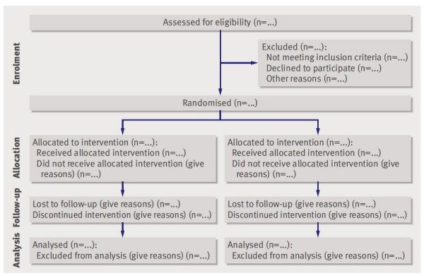
CONSORT-most widely accepted

Slide 11



