Slide 1
The Zen of Table-Making
Susan J. Henly
Editor, Nursing Research

Slide 2
communicating results
tables
figures
images
supplemental digital content
Kovach, C. R., Henly, S. J., & Clarke, S. P. (2014, August). Nursing research journals: Wrestling with the challenges. Panel presentation
at the Annual Meeting of the International Academy of Nursing Editors, Portland, ME.

Slide 3

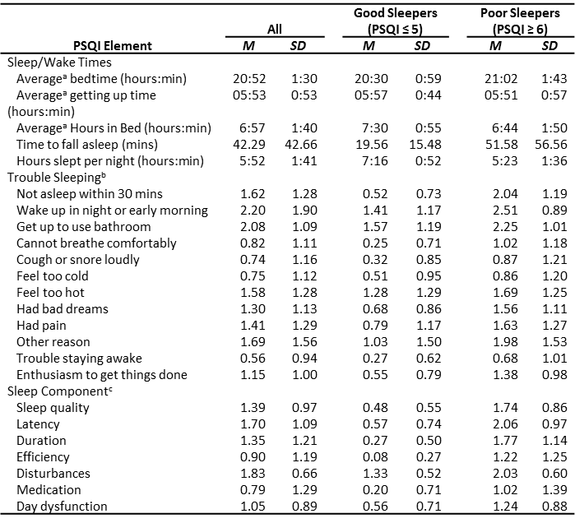


Harner, H. M., & Budescu, M. (2014). Sleep quality and risk for sleep apnea in incarcerated women. Nursing Research, 63, 158-169.

Slide 4

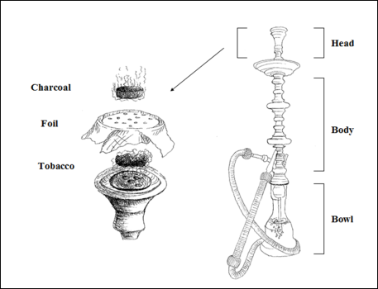

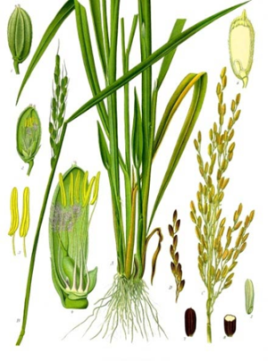
Rezk-Hanna et al. (2014). Hookah smoking among young adults in Southern California. Nursing Research, 63, 300-306.
http://www.sciencekids.co.nz/pictures/plants/riceplantdiagram.html

Slide 5
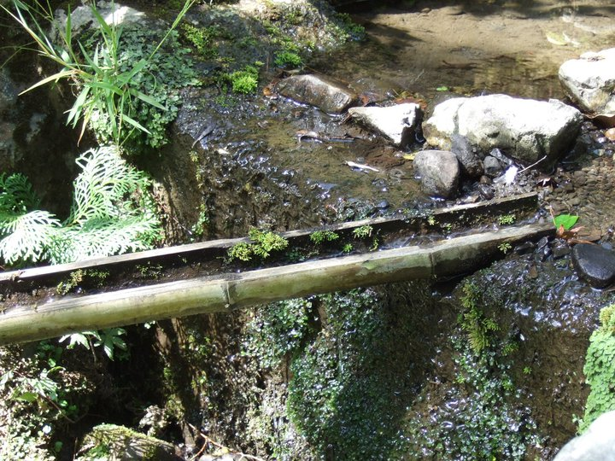
Montpetit et al. (2014). Telomere length: A review of methods for measurement. Nursing Research, 63. .

Slide 6
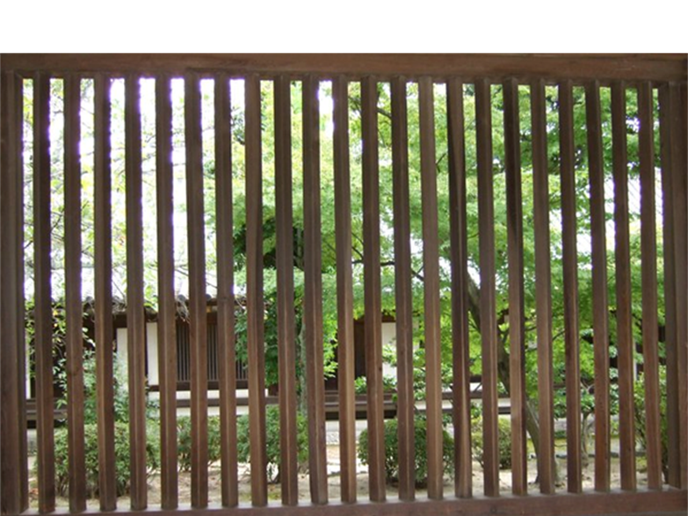
Swedish | English
Så den sommaren kunde vi inte åka någonstans privat utan jag fick hålla mig till en toalett, det var det enda som existerade I mitt liv. Hela vardagen var upplagd efter vart toaletterna fanns. | That summer we couldn’t travel anywhere. I had to stick to the toilet: it was the only thing that existed in my life. The entire day was organized around where the toilets were.
Och sedan att alltid, alltid, alltid ha med sig kateter. Det ligger ju påsar med klädnypor och katetrar och speglar överallt. Nu vågar jag inte ens pröva att tappa utan spegel. | And then to always, always, always bring catheters. There are bags with pins, catheters and mirrors everywhere. Now I don’t even dare to try to catheterize without a mirror.
Joelsson-Alm et al. (2014). Micturition problems after bladder distension during hospitalization in Sweden: “I’m not ill, just damaged
for the rest of my life.” Nursing Research, 63.

