Slide 1

A tweet, a blog, a podcast: Lessons from Evidence Based Nursing
Dr Alison Twycross^{1, 2} and Dr Allison Shorten^{1, 3}
¹ Evidence Based Nursing
² London South Bank University
³ Yale University

Slide 2
Overview
Evidence Based Nursing
Blogs and podcasts
Twitter Chat
Putting social media into practice

Slide 3
Evidence Based Nursing (EBN)
Commentaries
Editorials
Research made simple
Notes:
AT to introduce EBN talk on publication types
Editorial team – stress international team
Frequency of publication online line and print, indication of readership etc

Slide 4
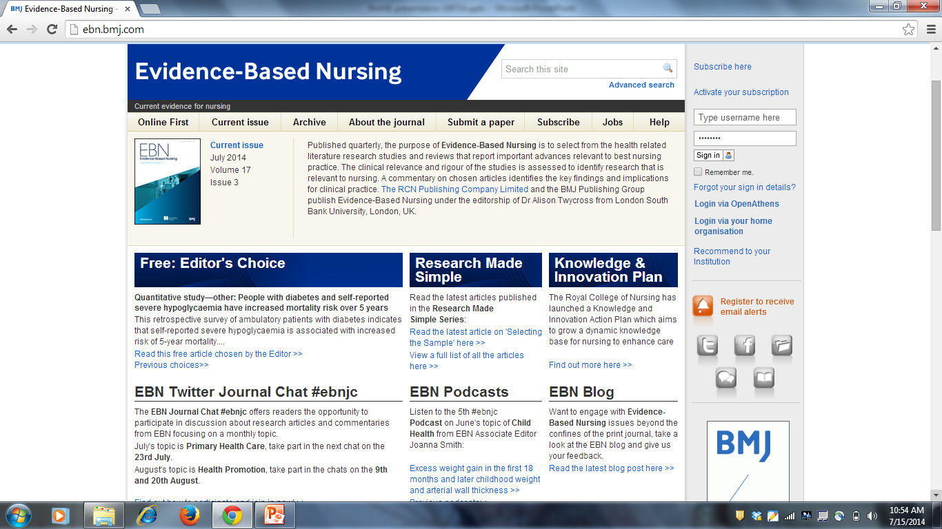

Slide 5

EBN and SoMe (#EBNJC)
Facebook
Podcasts
Blogs
Twitter
Storify
Notes:
Talk of how the journal has expanded to meet the needs of its nursing community through a multi media approach

Slide 6
Blogs and podcasts
EBN Blog posted weekly
EBN podcasts monthly
Both available via: http://ebn.bmj.com
Notes:
AS to reflect on Blogs and podcasts and how we use them at EBN – e.g. now linked to Twitter Chat

Slide 7
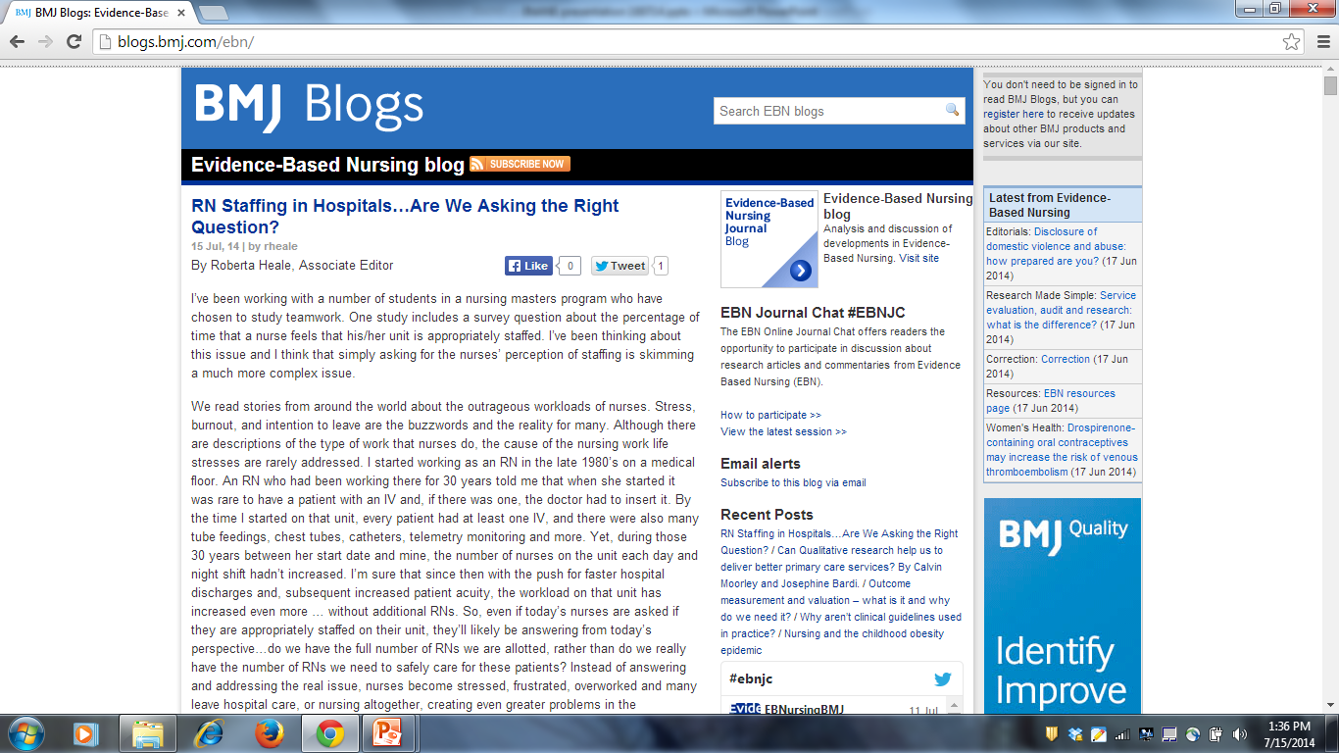

Slide 8
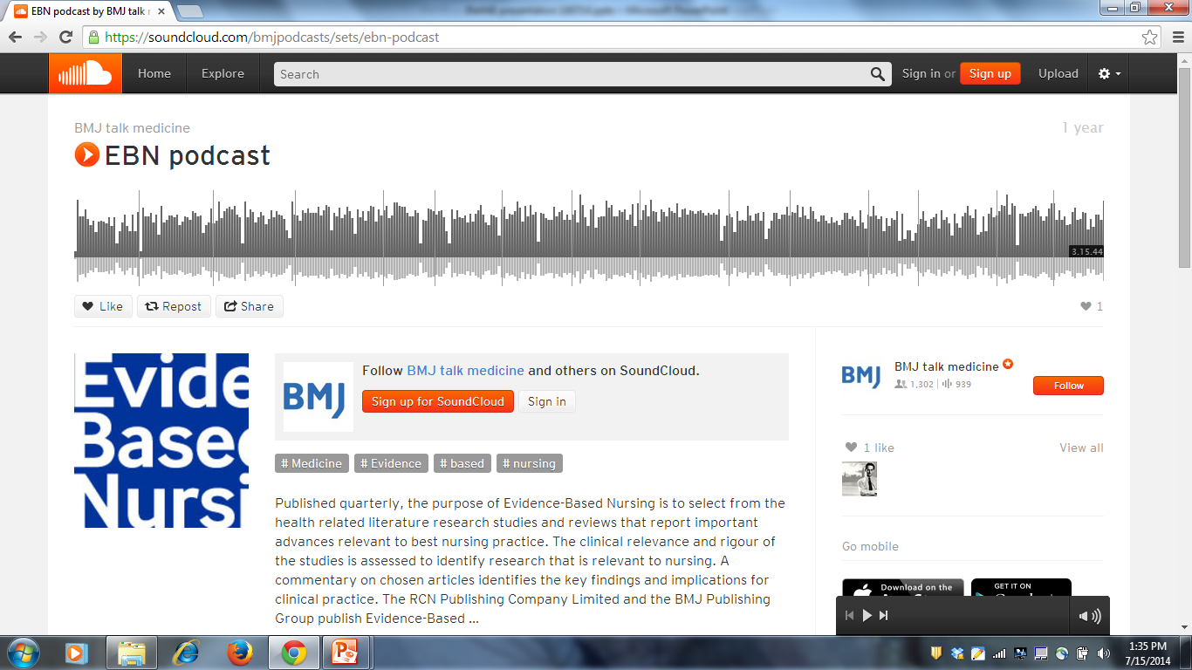

Slide 9




Journal Club
#EBNJC
Notes:
AT to talk of the EBN journal club its origins and aims

Slide 10
Challenges & Rewards #EBNJC
Setting times
Follower commitment
Digital literacy skills
Blocking of SoMe by employers
Ethical issues
Greater interaction
Wider audience
Sharing knowledge
Improving practice
Developing nursing research community
Challenges
Rewards

Slide 11
How to participate in #EBNJC
Step 1: Create a twitter account and then…
Follow the discussion by searching for links to #ebnjc or @EBNursingBMJ in Twitter
Contribute to the discussion by sending a tweet starting with @EBNursingBMJ and ending with #ebnjc (the EBN chat hashtag).
NB: you must include #ebnjc so people following the chat can see your contribution.

Slide 12
Hosting a Twitter Chat
Invite a co-host
Have questions and discussion points ready
Use 140 characters including hashtag
Start by welcoming people to the chat
Ask people to introduce themselves and welcome them
Keep people focused
Reminder 10 minutes before the end

Slide 13
Hosting a Twitter Chat
Dashboards give you a view of incoming tweets:
Comments – made by followers or others
Retweets – when someone re-posts a tweet
Mentions – when someone includes your twitter name in a tweet.
Tweet deck
Hootsuite
https://api.twitter.com/oauth/authorize?oauth_token=gFTZubWWUdzZS0q7uiI2YOSV9Mt3Wvo6MwroKftA
Both can be downloaded online for your computer or via the App store for mobile devices.
TWEET DECK
HOOTSUITE

Slide 14
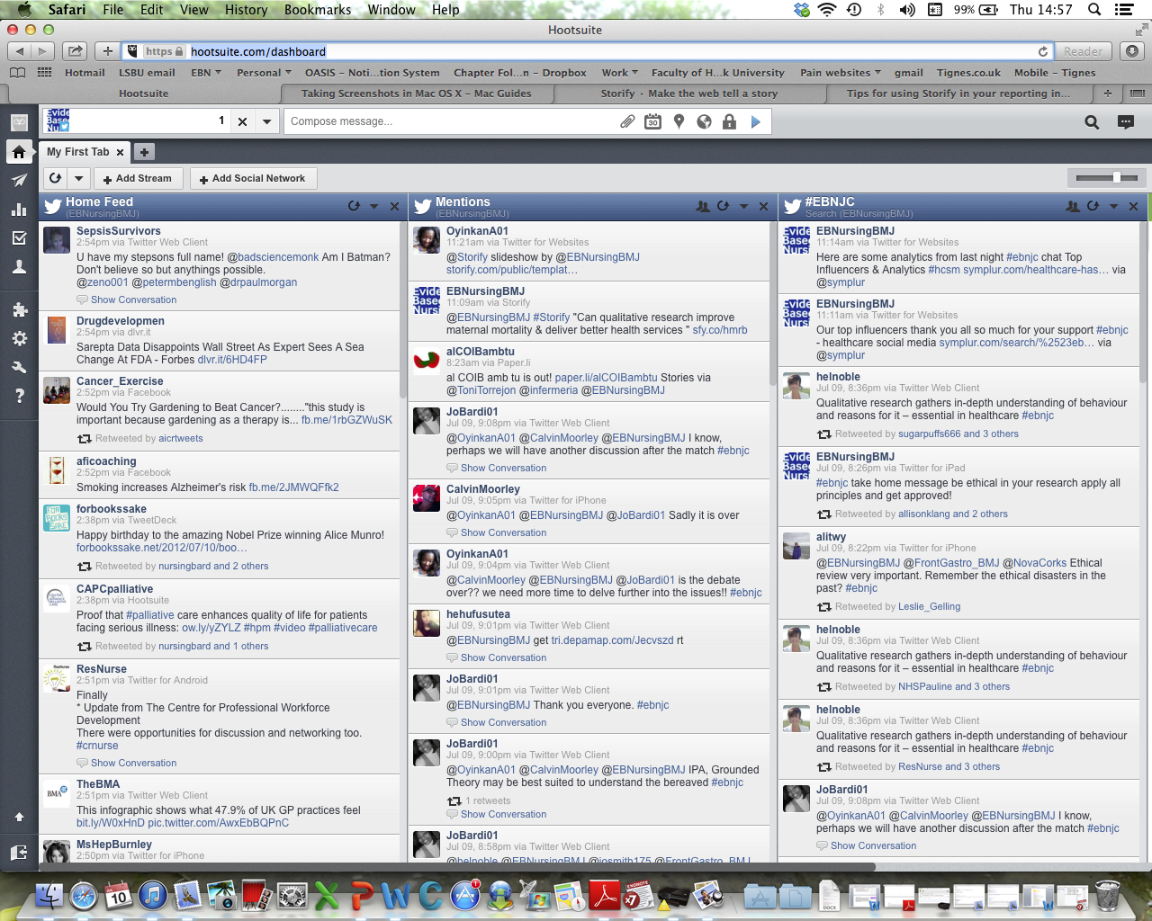
https://hootsuite.com/dashboard

Slide 15
Hosting a Twitter Chat 3
Summarize the different parts of the discussion to create a story
Use Storify: https://storify.com
Allows you to order Tweets logically and add in some text.
Example at: https://storify.com/EBNursingBMJ/why-aren-t-clinical-guidelines-used-in-practice

Slide 16
Let’s have a go
Topic: How do you see social media working for your journal?
Log onto Twitter
Search for links to #ebnjc or @EBNursingBMJ
Contribute to the discussion by sending a tweet starting with @EBNursingBMJ and ending with #ebnjc

Slide 17
Using Storify
Go to: https://storify.com
Log on via Twitter
Useful YouTube® video: https://storify.com/craignewman/tips-for-using-storify-in-you-reporting

Slide 18
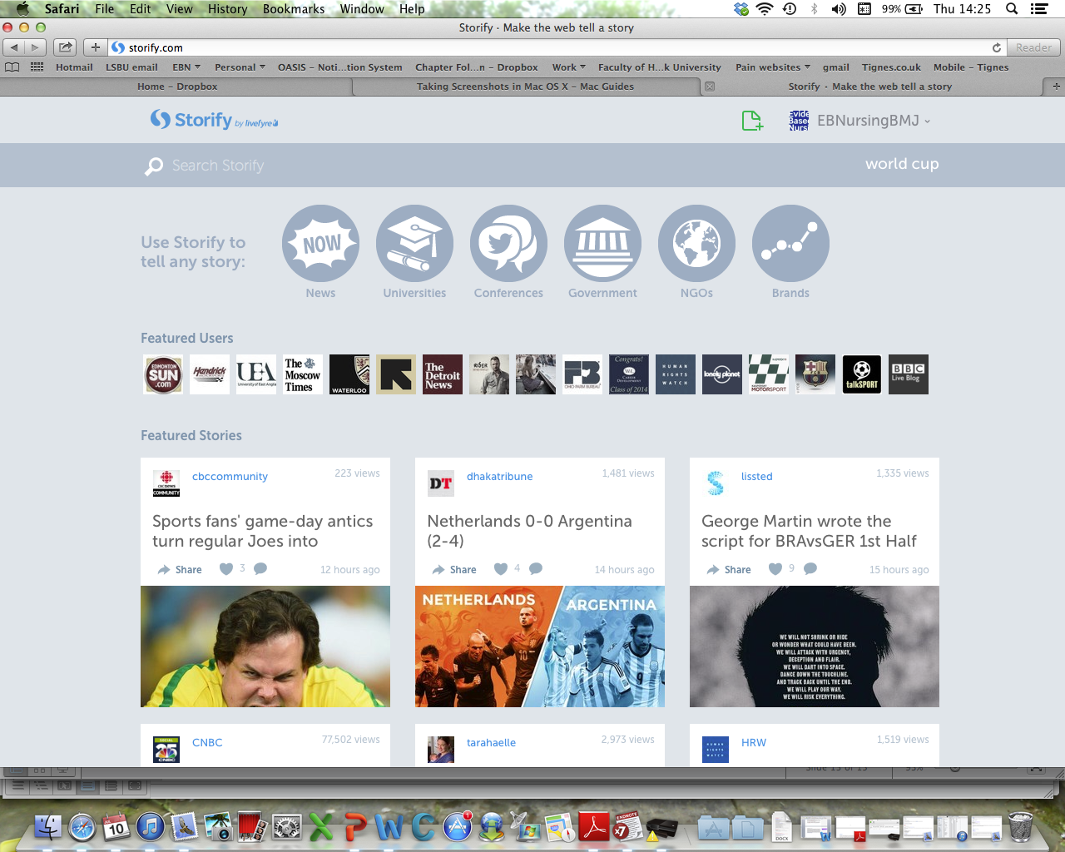
Telling a story with Storify

Slide 19
Sign up to Twitter at www.twitter.com
Follow us on Twitter:
EBN: @EBNursingBMJ
INANE: #INANE2014

Slide 20
Other resources
Nursing and Midwifery Council guidance on using social media:
  http://www.nmc-uk.org/Nurses-and-midwives/Regulation-in-practice/Regulation-in-Practice-Topics/Social-networking-sites/
How to host a Twitter Journal Chat EBN guidance available on request from: a.twycross@lsbu.ac.uk

Slide 21

xperts critically appraise the validity of the most clinically relevant articles in all nursing specialties and Time-saving, distilled research information in all medical specialties
– the journal filters the research to provide essential evidence-based studies, so readers can avoid spending time reading research that won’t affect their nursing practice
No other nursing title provides evidence-based commentary in this succinct format
Leading source of articles for student nurses
ebn.bmj.com

