Slide 1
Stop the Inanity !
Predatory publishers’ blunders and oddities

Slide 2
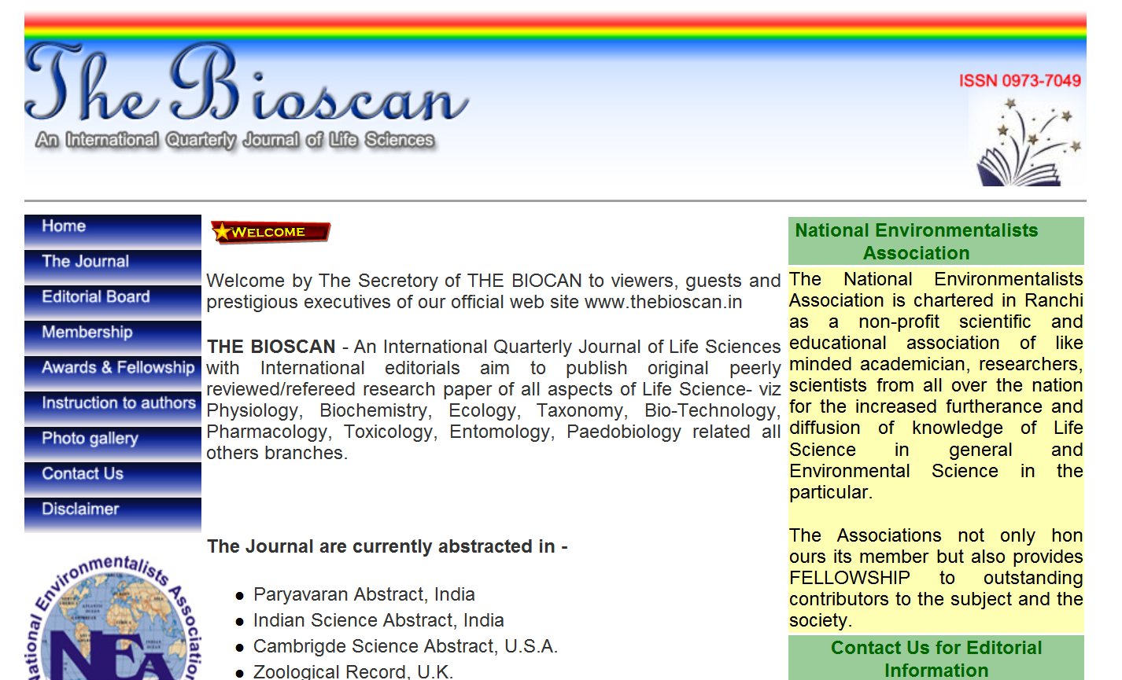

Slide 3





Slide 4


Slide 5
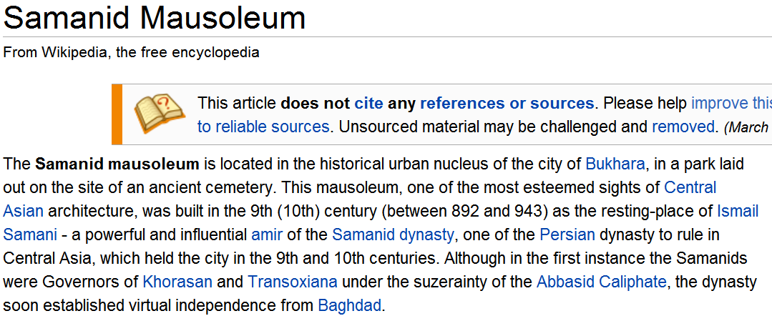

Slide 6


Slide 7
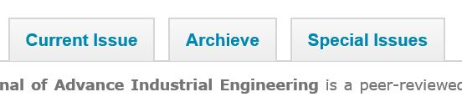

Slide 8
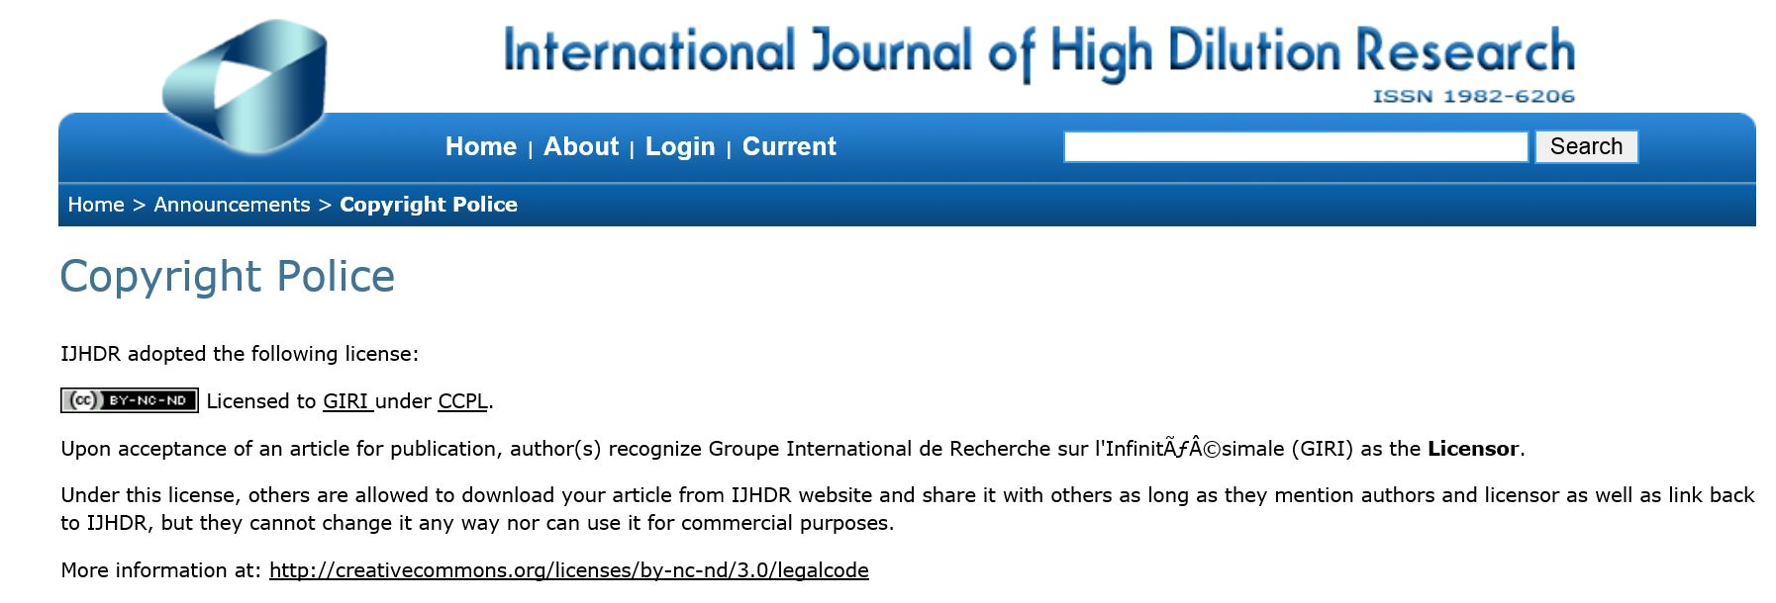

Slide 9


Slide 10
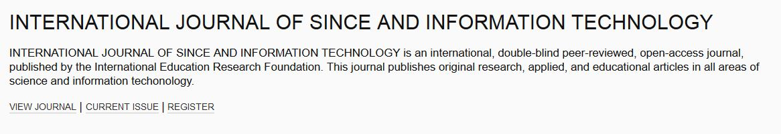

Slide 11


Slide 12


Slide 13


Slide 14
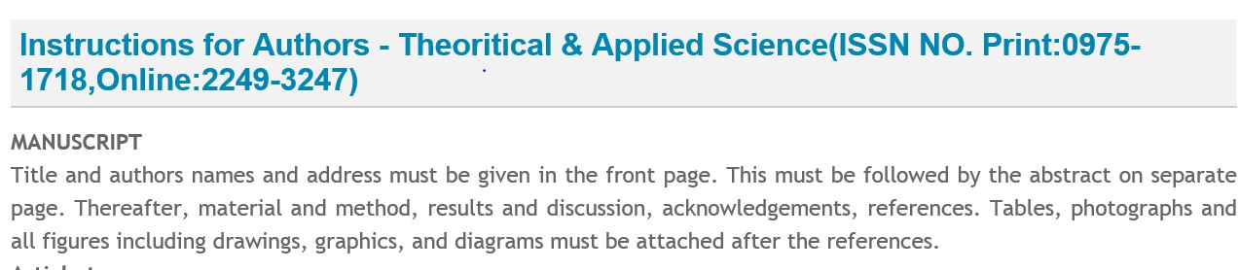

Slide 15
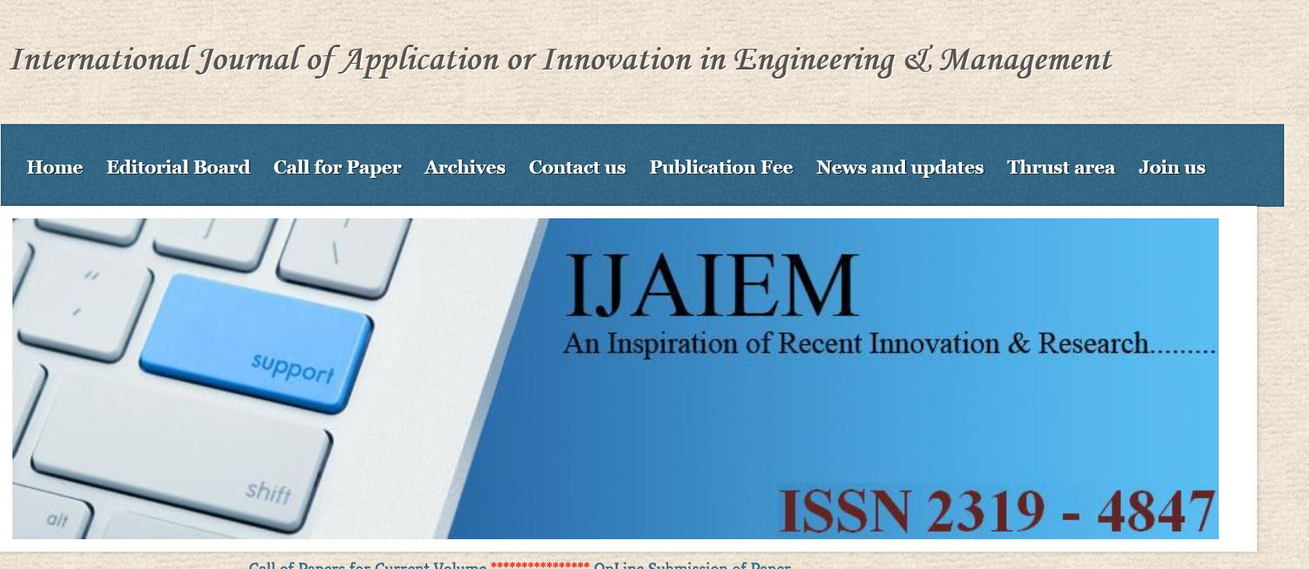

Slide 16


