Slide 1
Open Access or Good Editors Stand Out in a World of Predatory Publishers
INANE 2014, Portland ME
Carolyn Yucha, RN, PhD, FAAN
Dean, Schools of Nursing & Allied Health Sciences
University of Nevada, Las Vegas

Slide 2
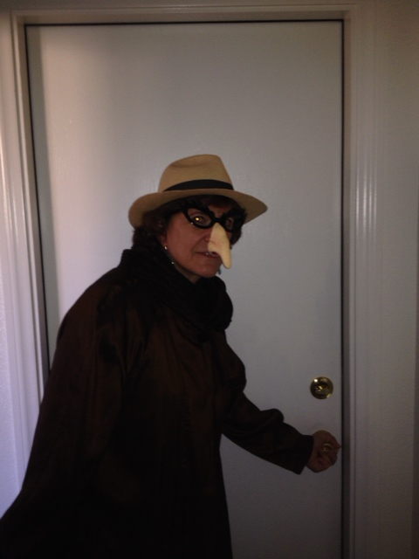
OMICS Conference
Las Vegas, NV
December 2, 2013
Ready to go undercover

Slide 3
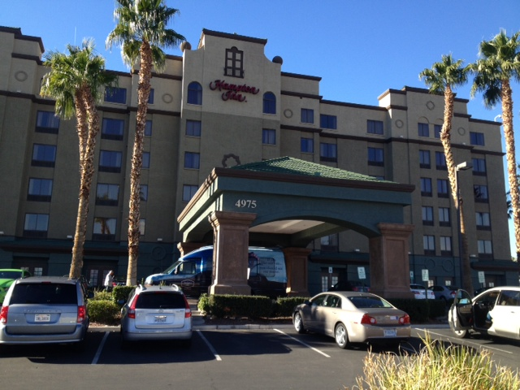

Slide 4
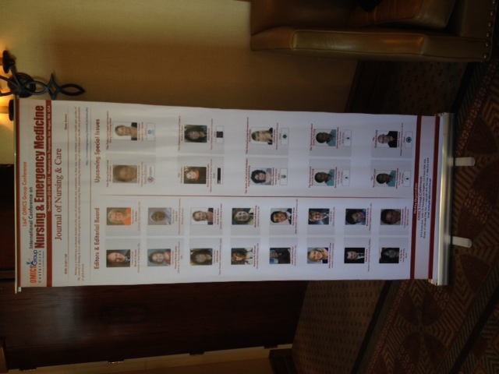
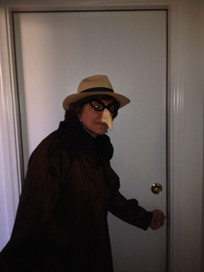

Slide 5
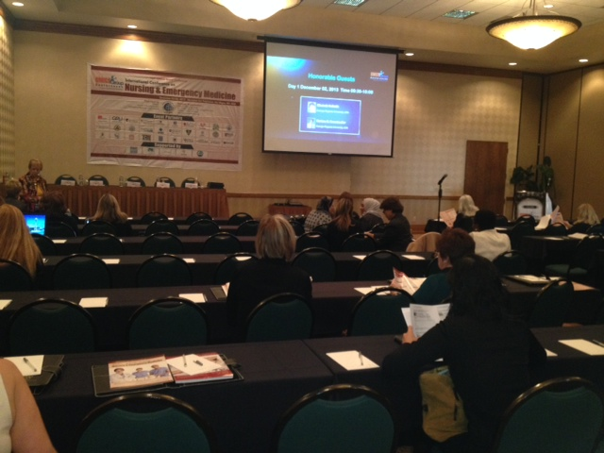

Slide 6
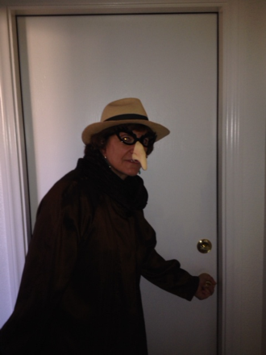
Attendees
Room set up for about 100 participants
  Counted 60
Breakout room for 32 participants
From all over the world

Slide 7
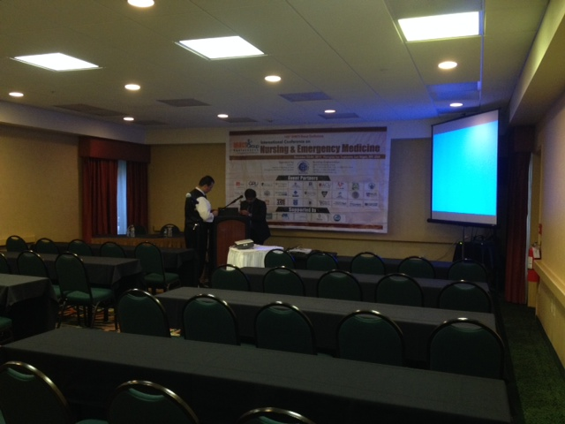

Slide 8
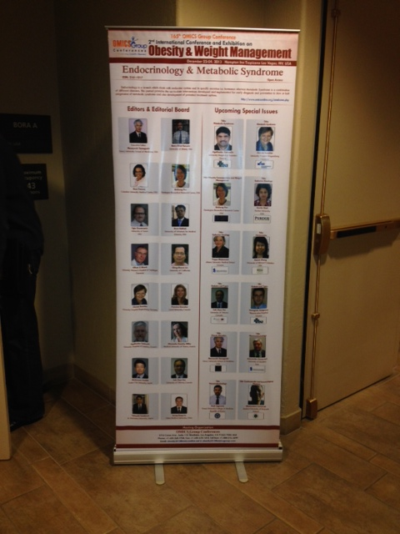
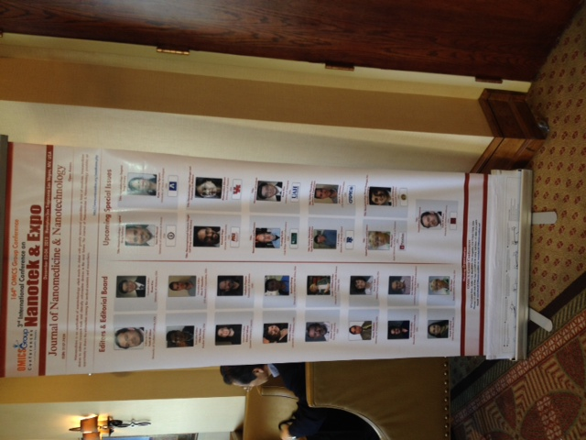

Slide 9
From Website on December 1, 2013
http://www.omicsgroup.com/conferences/nursing-emergency-medicine-2013/
To Collaborate Scientific Professionals around the World
Dates of the Conference | December 2-4, 2013
Venue of the Conference | Las Vegas, USA
Theme | Exploring the Current Issues & Challenges in the Path of Nursing & Emergency Medicine
Sponsors | Click here for Sponsorship Opportunities
Speaker Opportunity | Day 1 | Day 2 | Day 3
 | Available | Available | Available
Poster Opportunity | Available

Slide 10

Special Issues
All accepted abstracts will be published in respective OMICS Group Journals
Each abstract will be provided with Digital Object Identifier by

Slide 11
Conference Highlights
Psychiatric & Mental Health Nursing Cancer Nursing
Emergency Medicine Clinical Nursing
Pediatric Emergency Medicine Legal Nursing
Acute Ischemic Nursing Cardiac Nursing
Adult Health Nursing Nursing Education
Critical Care Nursing Pediatric Nursing
Women Health Nursing Emergency Nursing

Slide 12
How to cover all these topics?
Tracks are combined!
11:35-17:55 | Track 1: Psychiatric & Mental Health Nursing Track 3: Emergency Medicine Track 5: Pediatric Emergency Medicine | Salon B
11:35-18:35 | Track 2: Cancer Nursing Track 4: Clinical Nursing | Tahiti

Slide 13
Day 2
9:55-16:50 | Track 8: Cardiac Nursing Track 9: Adult Health Nursing Track 10: Women Health Nursing | Salon B
9:55-13:30 | Track 6: Critical Care Nursing Track 7: Acute Ischemic Nursing | Tahiti

Slide 14
Day 3
8:30-14:55 | Track 11: Legal Nursing Track 12: Pediatric Nursing Track 14: Emergency Nursing | Salon B
8:30-17:50 | Track 13: Nursing Education | Tahiti

Slide 15
Legal, Pediatric & Emergency
Older adults following disasters: A flex-model for long term assessment
The role of the nurse in the fight against childhood obesity
Development of a smartphone application to improve the accuracy & management of hypertension in children & adolescents
Animal - assisted therapy with children with autism spectrum disorder
Evolution in emergency care: The pivot team
Effectiveness of coronary computed tomography as tool in emergency department patients with acute chest pain
The emergency nurse's perception of incivility the workplace
Nursing medical malpractice - The elephant in everyone's room
Maintaining a safe work environment in the emergency department
Children's experiences of acute hospitalization to a pediatric emergency & assessment unit
Pre-hospital care service: Policies & advances
The journey of patients with acute abdominal pain in the ED, EDOU & surgical assessment unit
Hospitals’ characteristics impact on 30-day mortality & readmission rates

Slide 16
Feedback (n=1)
Worst conference ever
Traveled halfway around the world to give a talk to 5 participants
Keynote speaker did not show up
Food was poor & not enough
Some of the talks were good

Slide 17
Benefits
Apparently meets a need for presentations at international conferences
Presenters have their work published

